Slide 1

Population Stratification 2016 Summer Workshop CEDUA El Colegio de Mexico, A. C.
Ben Domingue

Slide 2
Today’s Goals

Slide 3
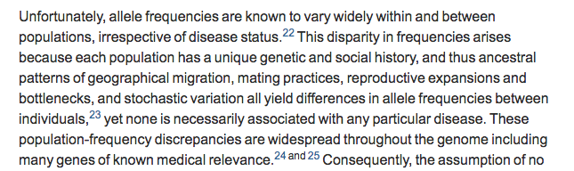
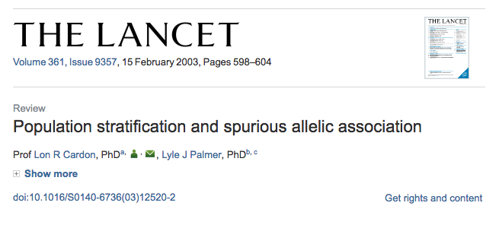
What is population stratification (pop strat)?

Slide 4
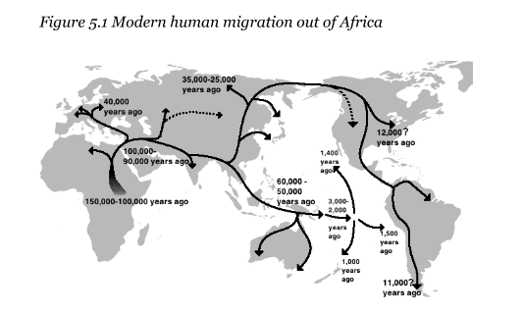
Why does it exist?

Slide 5
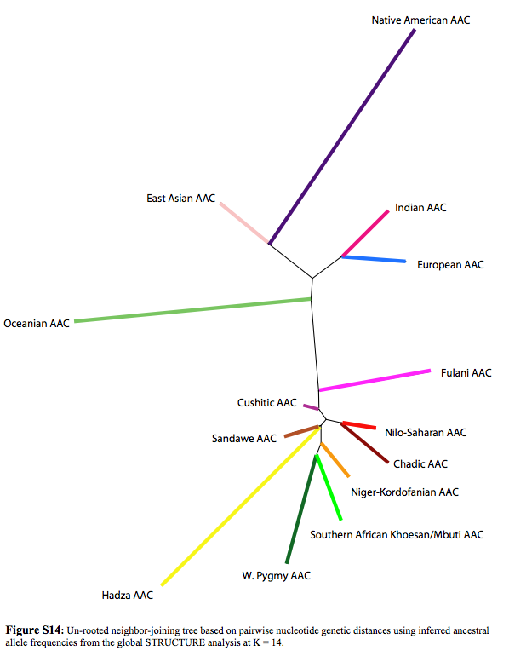
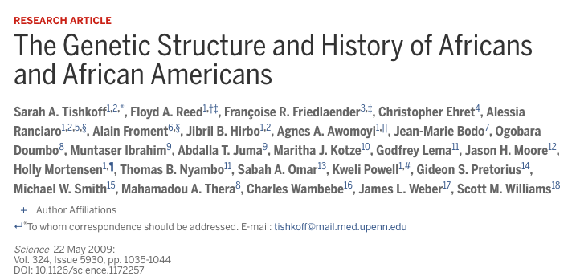

Slide 6
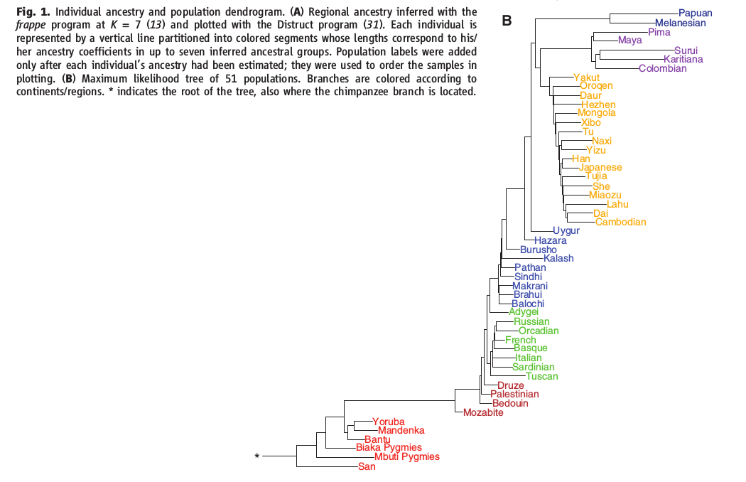
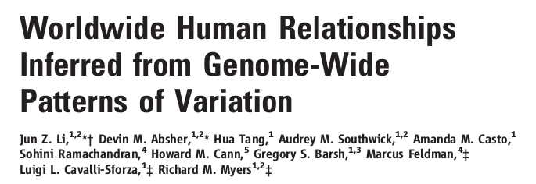

Slide 7
How does it come about
Selection: Change in allele frequency due to survival and reproductive advantages associated with a phenotype.
Drift: Change in allele frequency due to random sampling.
Hard to distinguish between the two.

Slide 8
Technically relevant details
Linkage
Haplotype
Tag SNPs

Slide 9
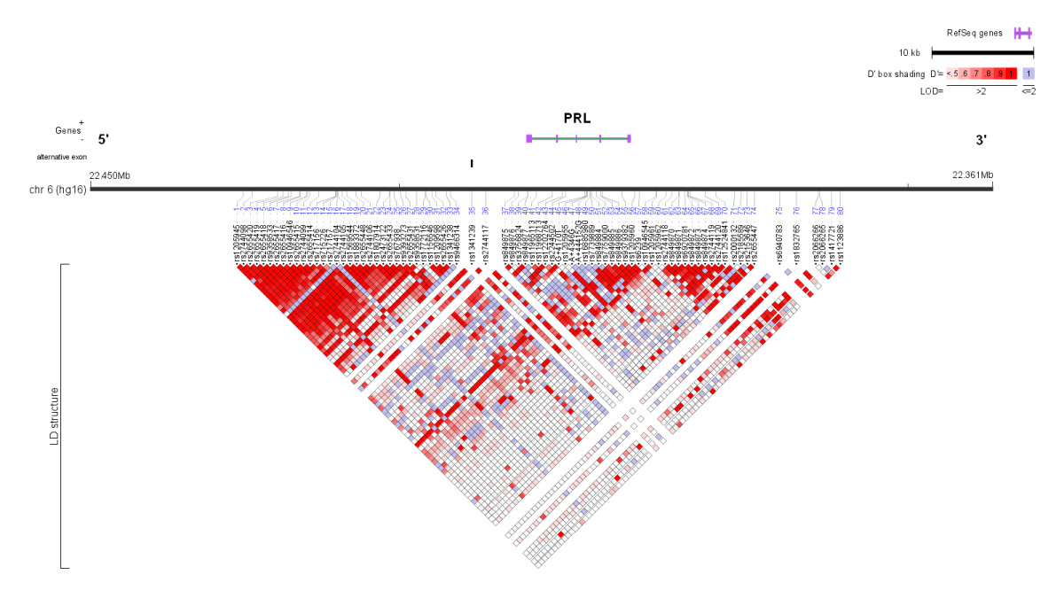
Linkage map
Tag SNPs
Linkage patterns vary across population.
Tag SNP in one group may not tag same gene in different population.

Slide 10
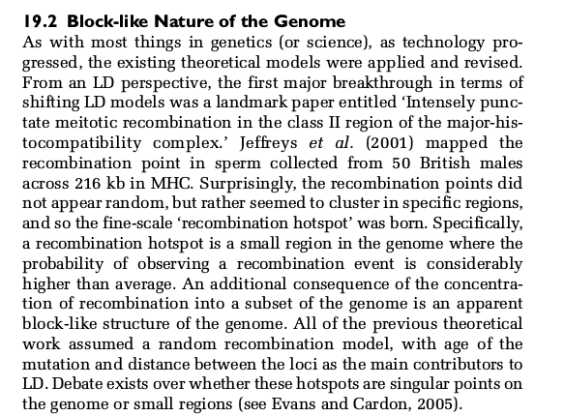
Why do we see this?

Slide 11
Haplotypes
A haplotype is a group of genes or alleles inherited together from a parent

Slide 12
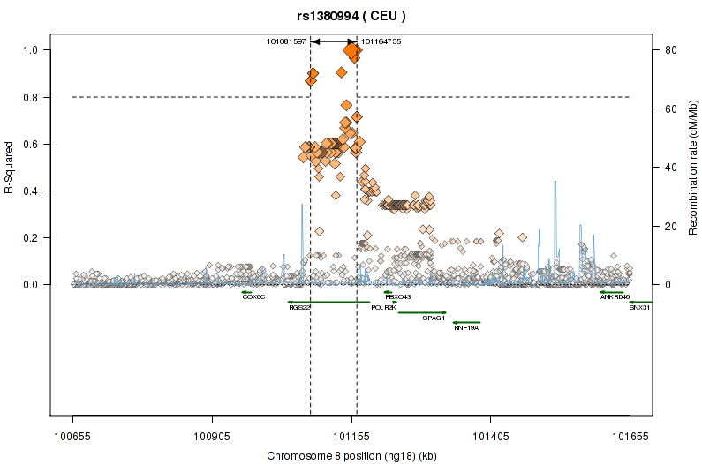
Tag SNPs

Slide 13
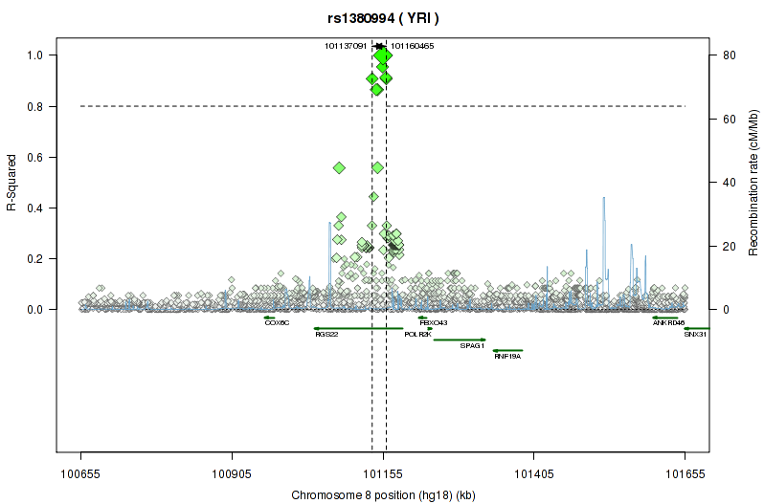
Tag SNPs

Slide 14
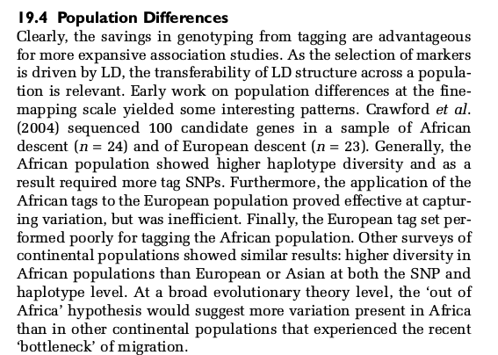
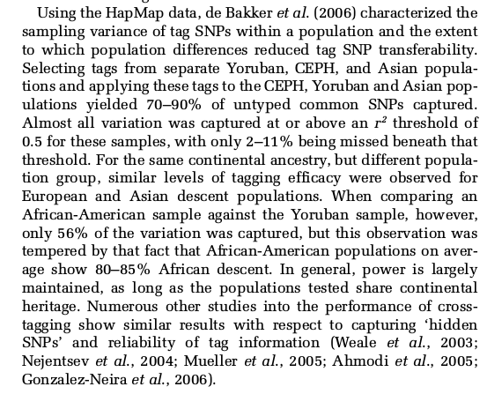
Tag SNPs and populations

Slide 15
Emphasizing the problem of getting things wrong

Slide 16
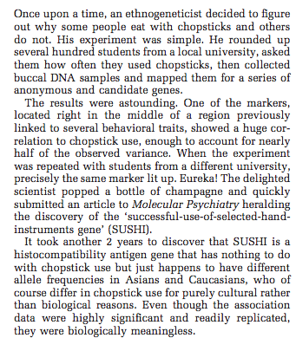
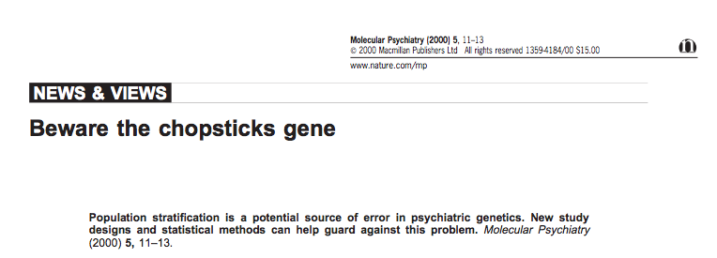
Chopsticks gene

Slide 17
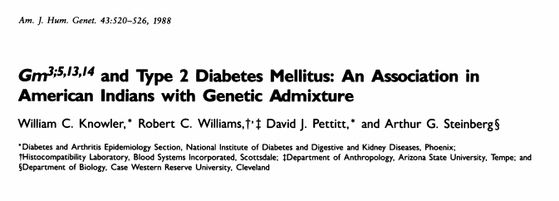
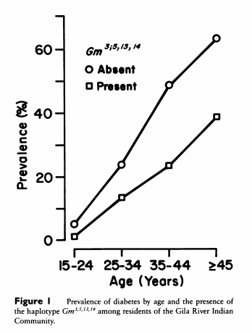
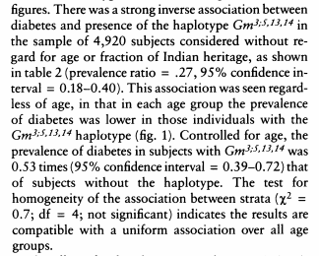
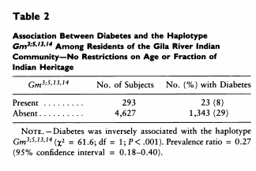
Classic example

Slide 18
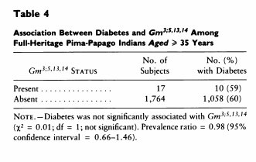
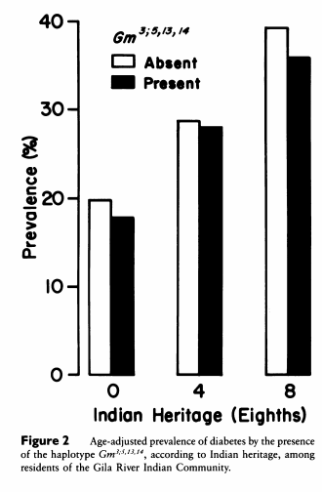
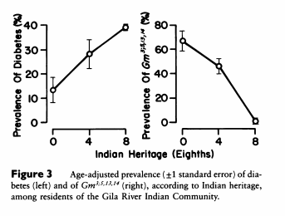
But association not present in homogenous sample (table 4) and is collinear with ancestral heritage.

Slide 19
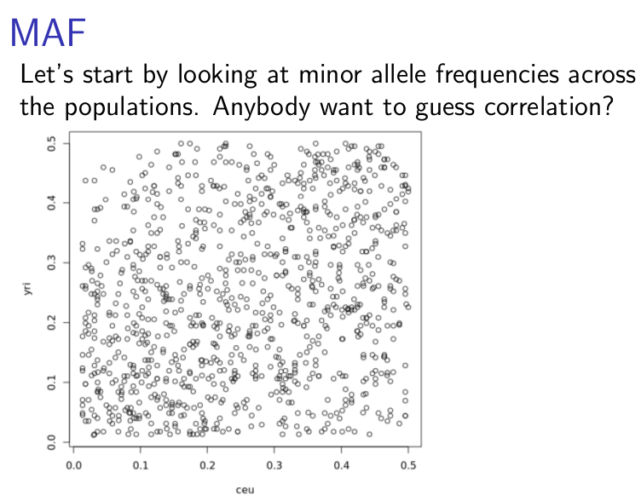
With genome-wide data, problem appears in minor allele frequencies

Slide 20
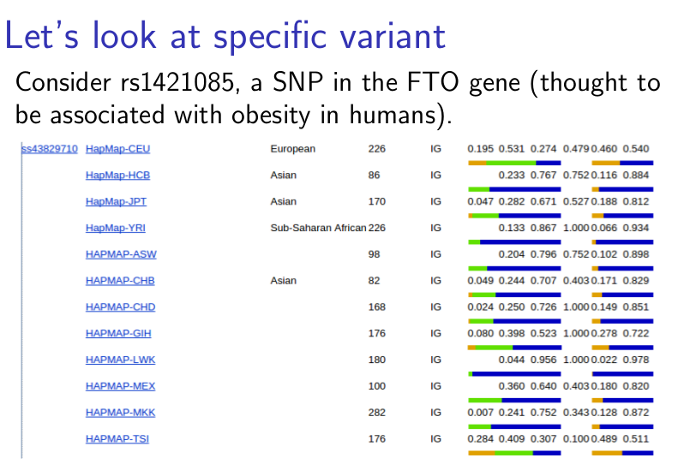

Slide 21
What to do about it
We’re going to talk about some analytical approaches that might be useful in working with heterogeneous groups.

Slide 22
PCs
Explore this brief tutorial on general idea:
http://setosa.io/ev/principal-component-analysis/
In context of genome-wide data, we are basically interested in identifying major sources of genetic variation. These end up having interesting properties.

Slide 23
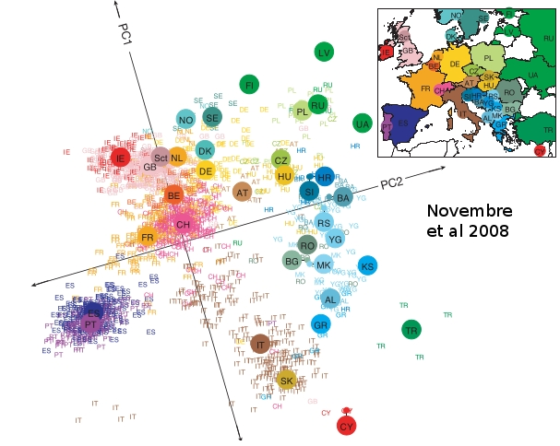

Slide 24
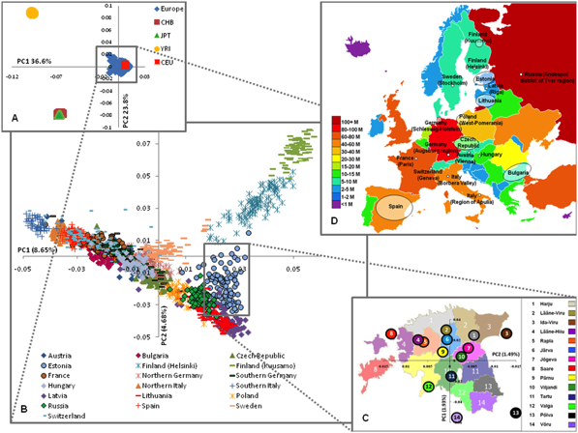
Nelis et al., 2009

Slide 25
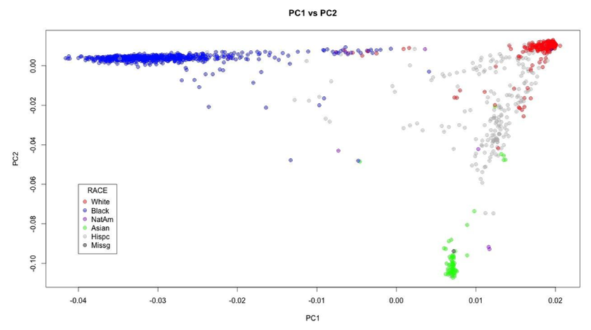
Principal Components by race
McQueen et al., 2014

Slide 26
Admixture
Interbreeding between previously isolated populations

Slide 27
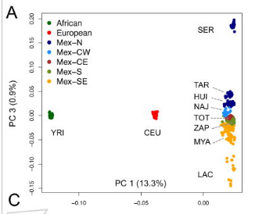
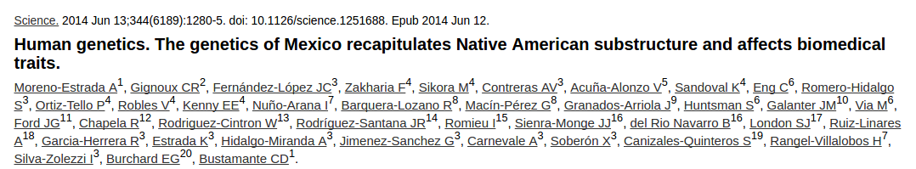
Paper on mexico

Slide 28
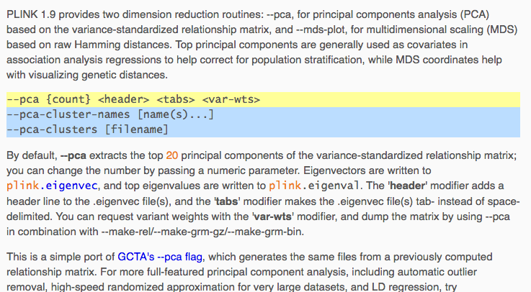
PCs

Slide 29
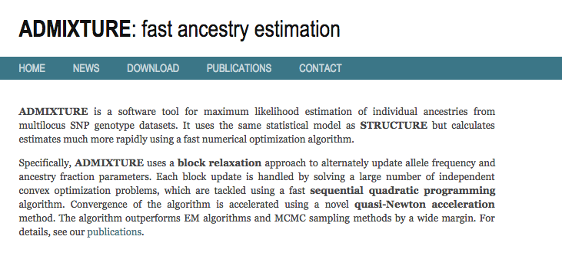
admixture
An alternative is to try to direction estimate ancestry.

Slide 30
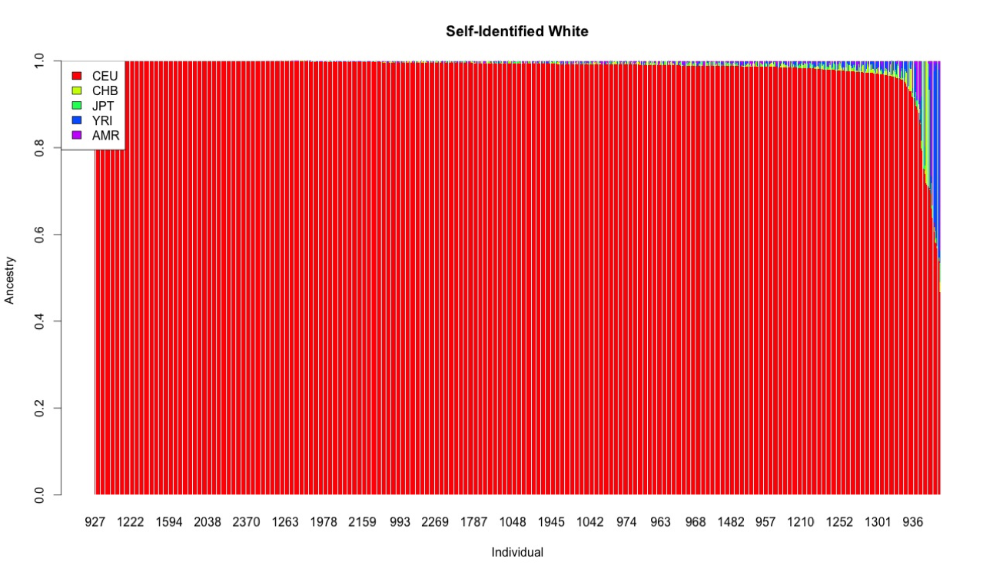
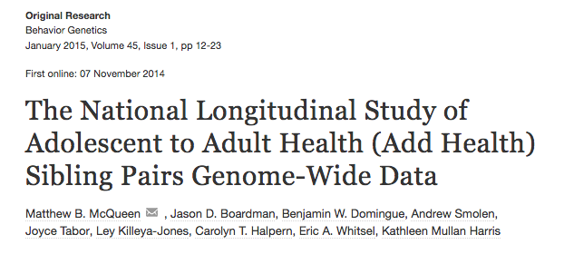
Examples from AH

Slide 31
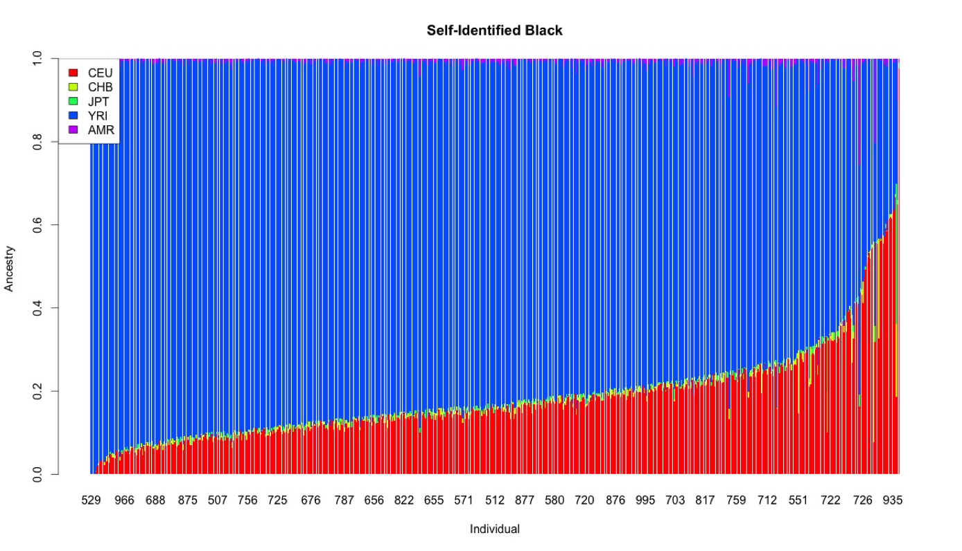
Examples from AH

Slide 32
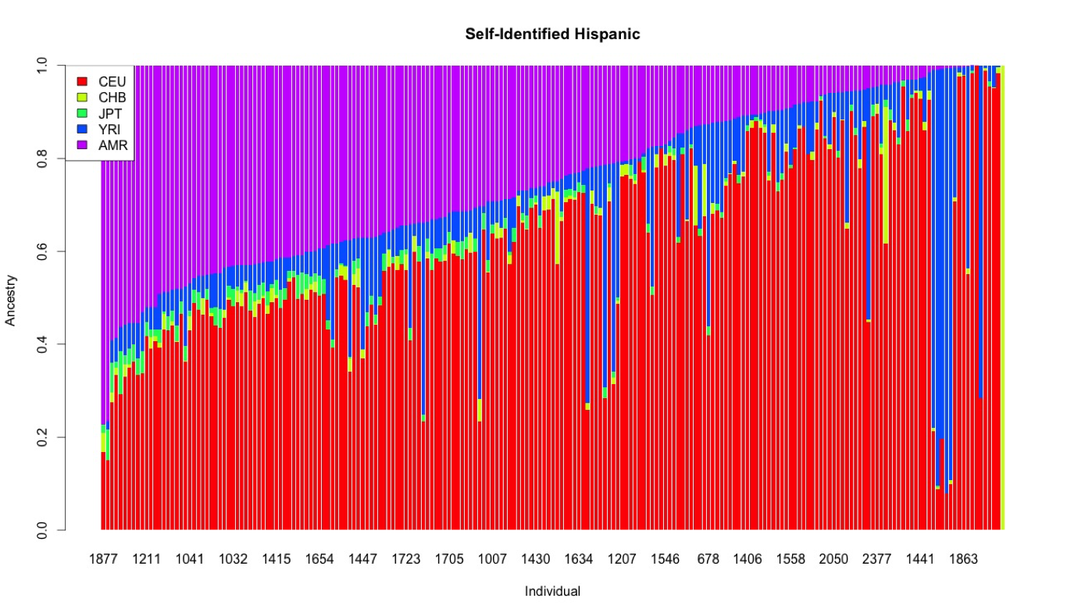
Examples from AH

Slide 33

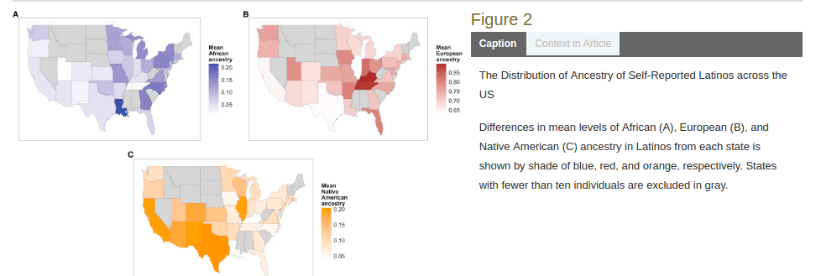

Slide 34
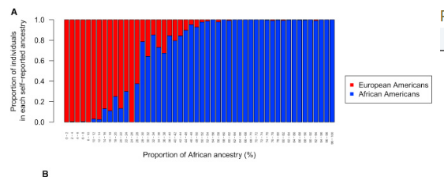
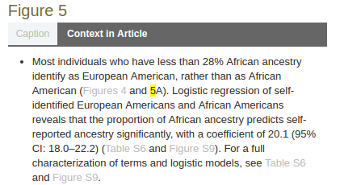

Slide 35
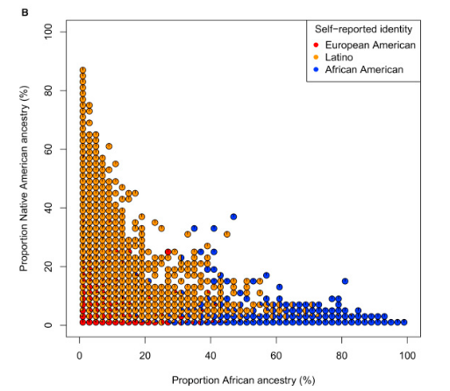
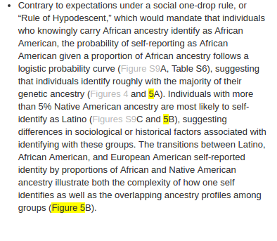

Slide 36
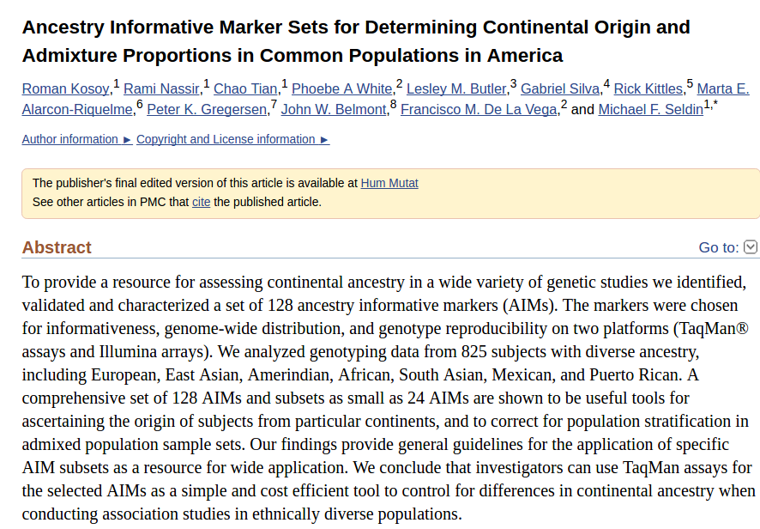
AIMs

Slide 37
Implications for social science
Race: socially constructed?

Slide 38
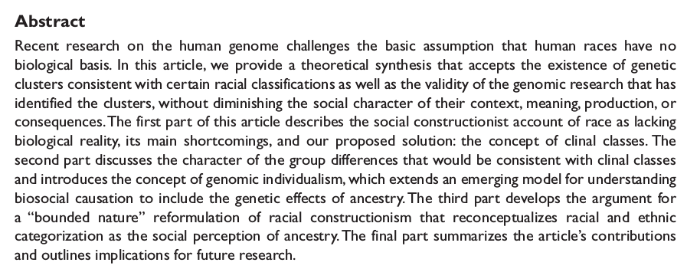


Slide 39
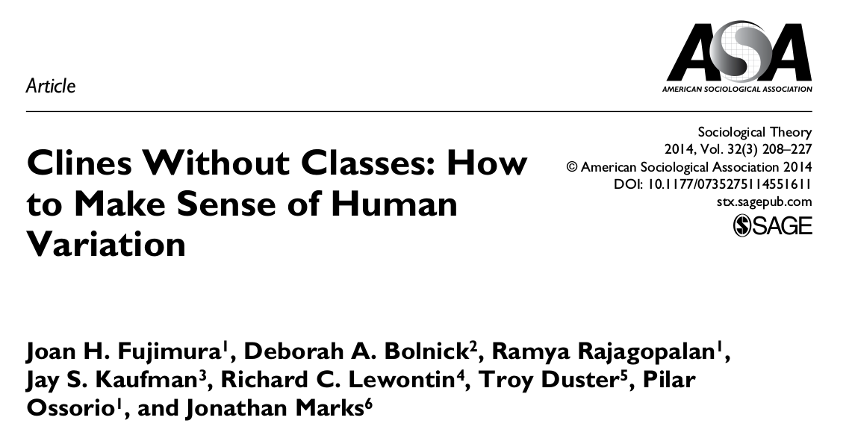
A strongly worded reply

Slide 40
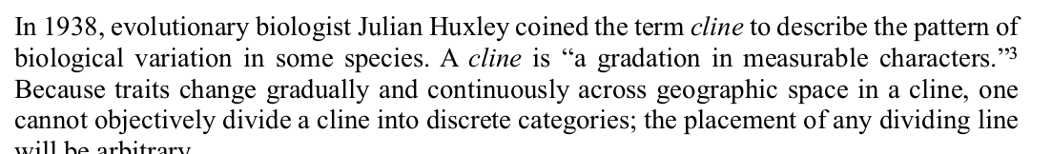
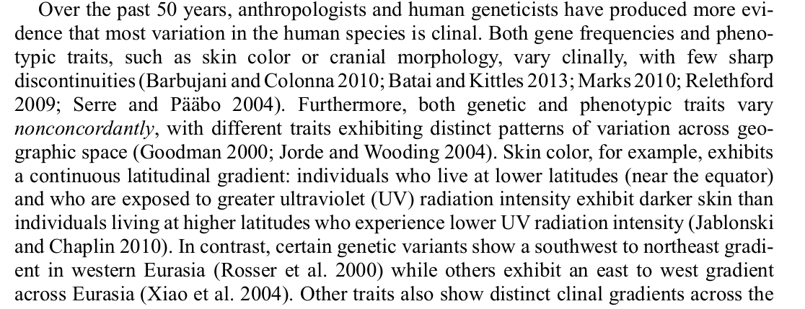
Clines not classes

Slide 41
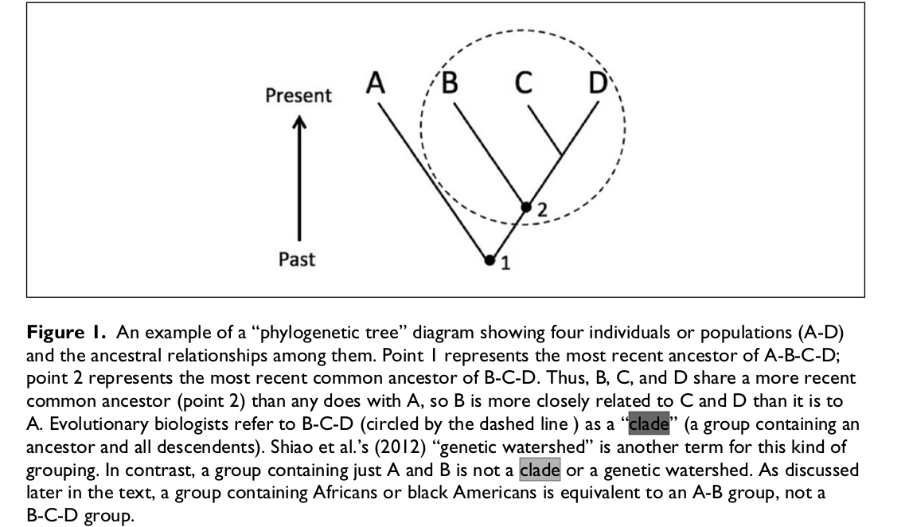

Slide 42
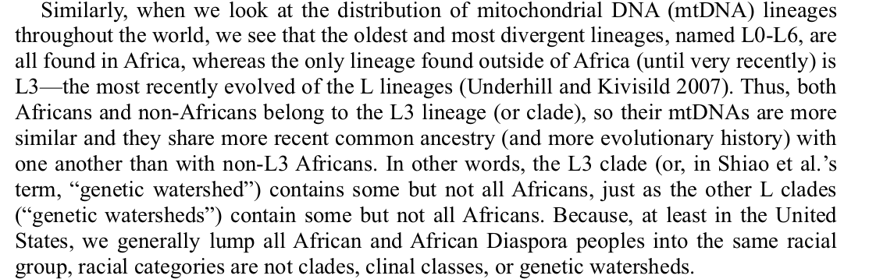

Slide 43
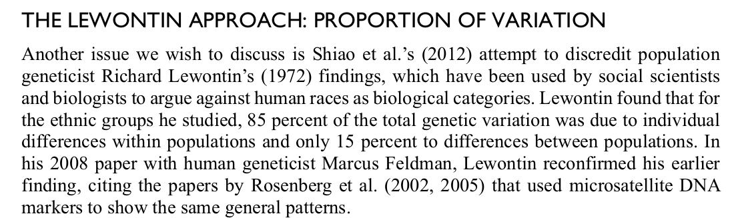

Slide 44
Research Focus #2
Based on your literature search yesterday and the data you noted, please start to outline a specific research question.
Rough is very ok at this point!
Do a second literature search focusing in on the particular topic you are curious about.
Please note any commonly occurring names in the literature!

